Slide 1
BASIC TRANSFORMATIONS & HISTOGRAM ANALYSIS
Notes:
“Good morning everyone. My name is Tuan Anh, and today I’ll be presenting on BASIC TRANSFORMATIONS & HISTOGRAM ANALYSIS
– a fundamental technique used to enhance image quality before deeper analysis.

Slide 2
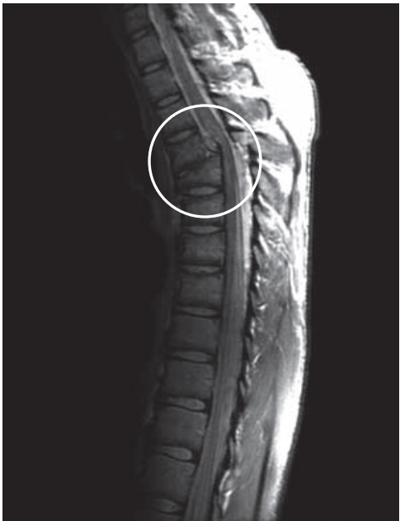
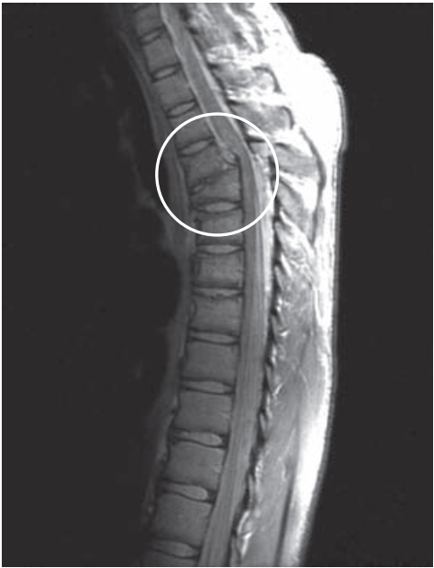
INTRODUCTION
Imbalance grayscale Image
Balance grayscale Image
Notes:
Why is this important? In many real-world scenarios — such as medical imaging or low-light photography — raw images often suffer from poor contrast or uneven brightness. This can seriously hinder later image processing tasks. Take a look at the image on the left, which is an imbalanced grayscale image: some details are unclear, and others are too dark to see properly. Intensity transformation provides an effective way to pre-process and enhance such images by redistributing brightness levels and improving visibility of important features.
The image on the right is the result of applying an intensity transformation. We can clearly see more details, including some that were previously hidden in the darker regions of the original image.

Slide 3
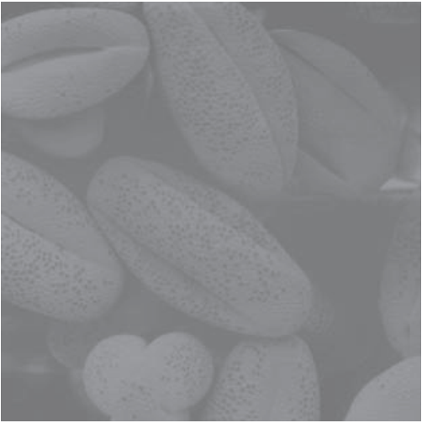
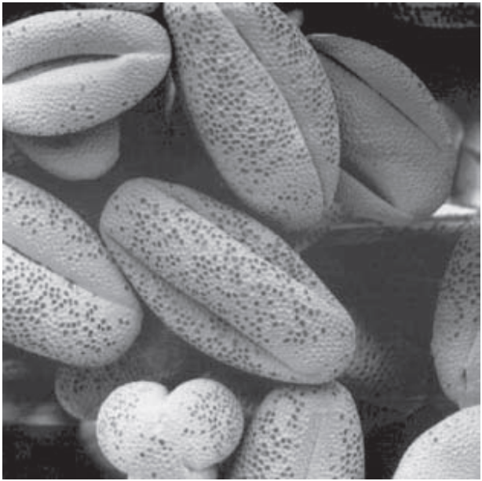
INTRODUCTION
Low contrast Image
High contrast Image
Notes:
In another example, the image on the left has low contrast. The details appear blurred, unclear, and the overall image looks dark. After applying an intensity transformation, the result on the right shows higher contrast, with sharper and more visible details.

Slide 4
OBJECTIVE
THE CORE CONCEPT OF INTENSITY TRANSFORMATION
COMMON TRANSFORMATION TECHNIQUES
HISTOGRAM-BASED METHODS
Notes:
Our goals today are simple. First, we’ll explore the core concept of intensity transformation. Then, we’ll look at some common transformation techniques and see how they affect images. Finally, we’ll cover histogram-based methods like equalization and matching.”

Slide 5
TABLE OF CONTENT
01
BASIC TRANSFORMATIONS
02
HISTOGRAM ANALYSIS
03
CONCLUSION
Notes:
“Here’s the roadmap for this talk. We’ll start with basic transformations, then move into histogram analysis. After that, we’ll conclude with key takeaways and applications.”

Slide 6
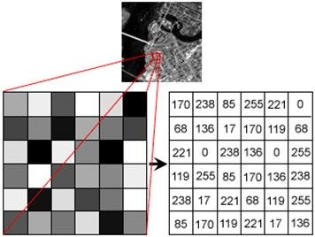
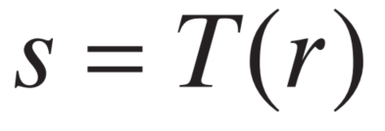
1. BASIC TRANSFORMATION
Output intensity levels
Input intensity levels
What is Intensity Transformation?
Intensity transformation function
Notes:
“Intensity transformation refers to the process of modifying pixel values in a grayscale image to enhance certain visual qualities. This is usually a point operation – meaning, each output pixel depends only on the corresponding input pixel.” Intensity transformation have formula shown on the screen. “The purpose of these transformations is to increase contrast, reveal hidden details, or adjust brightness levels. The output image is more suitable for human viewing or for automated analysis by computer vision systems.”

Slide 7
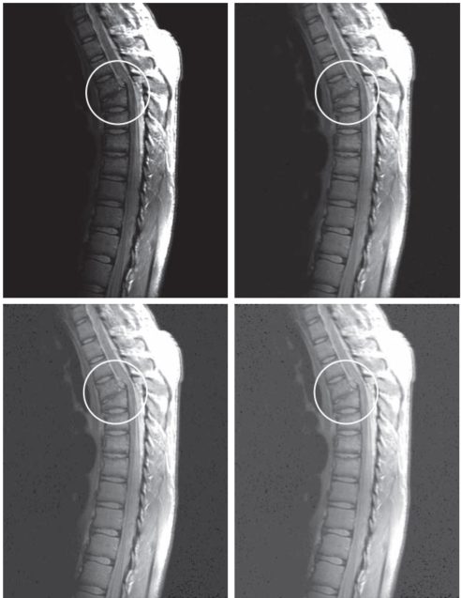
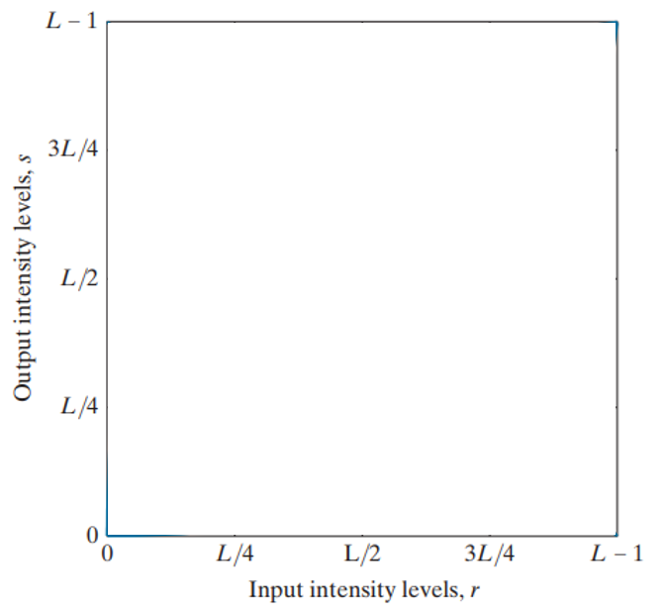
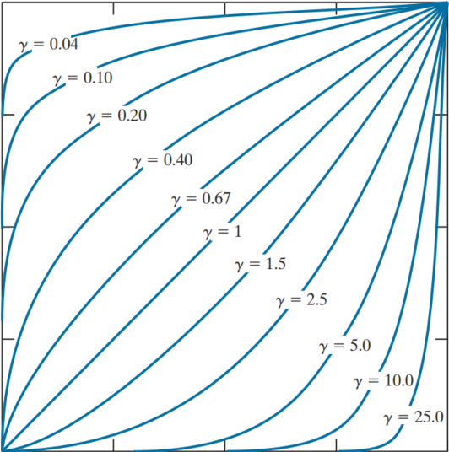
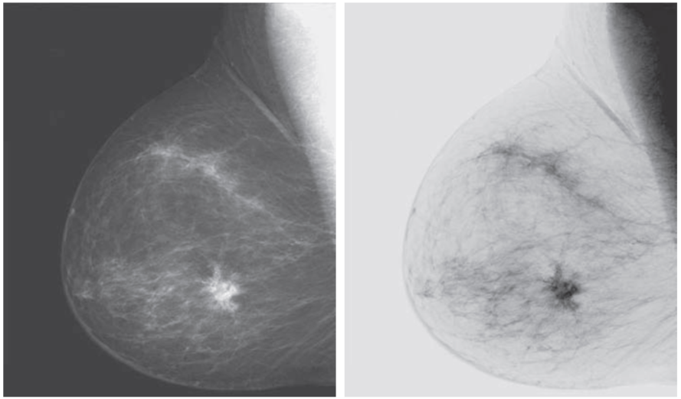
1. BASIC TRANSFORMATION
𝛾 = 0.6
Power – Law (Gamma) Transformation
Negative Transformation
s = L – 1 – r
Log Transformation
Identity Transformation
s = r
Negative
c: scaling constant
The "+1" ensures that log(0) doesn’t cause a math error.
c: a constant
𝛾 : gamma value
L: total number of possible intensity levels
(for 8-bit images, L = 256, so levels range from 0 to 255)
𝛾 = 0.4
𝛾 = 0.3
Log
nth root
Enhances dark regions, compresses bright regions.
Astronomical imaging: Reveals details in dark
Fourier spectrum visualization
Low-light medical or document images
Medical imaging (e.g., mammograms) to reveal details not easily seen in the original image
Photographic negative conversion
Enhancing low-light images
If 𝛾 = 1 : behaves like the identity transformation
If 𝛾 < 1: expands dark input values (brightens the image)
If 𝛾 > 1: compresses dark values (darkens the image)
Identity
𝛾 < 1
nth power
Gamma correction in monitors (e.g., CRTs with γ ≈ 2.2)
Image enhancement for different lighting conditions
Pre-processing before feature extraction or segmentation
Inverse Log Transformation
Inverse Log (exponential)
c: Scaling constant
e: Euler’s number (≈ 2.718)
𝛾 = 1
Enhances dark regions, compresses bright regions.
Astronomical imaging: Reveals details in dark
Fourier spectrum visualization
Low-light medical or document images
𝛾 > 1
Notes:
Identity transformation is the simplest form of intensity mapping, where each pixel retains its original value. It applies no change to the image. This transformation is useful as a baseline for comparison.
Next is Negative transformation inverts the brightness of each pixel using the formula s = L - 1 - r, where L is the total number of gray levels. This makes dark areas become bright and vice versa. It's especially useful in highlighting bright structures in dark images, like in X-rays or astronomical photos. As a result, it helps reveal details that are hard to see in the original image
Power Law Transformation is a non-linear technique used to adjust image brightness and contrast using the formula:
When gamma less than 1, the output intensity becomes greater than the input. This makes the image brighter, especially in dark regions. the output intensity increases faster for low input values.It expands dark areas and compresses bright areas, helping to reveal hidden details in shadows.
When gamma greater than 1 , the output intensity becomes less than the input. This makes the image darker, especially in bright regions. It compresses dark areas and expands bright areas, which can help reduce overexposed regions.
This is an example of image enhancement using different gamma values. However, applying a small gamma value can amplify noise in dark areas, especially if the original image has low-quality or underexposed regions. This is because noise that was previously hidden may become more visible after brightening.
Log Transformation and Power Law Transformation are quite similar. Both expand the dark regions and compress the bright regions, enhancing the image contrast.
Log Transformation is particularly effective at enhancing details in dark regions without significantly affecting the bright areas. It is simple and easy to control.
Power Law Transformation (with γ<1\gamma < 1γ<1) can also brighten dark regions, but it requires precise adjustment of the γ\gammaγ value. If γ\gammaγ is too high or too low, the image may become overexposed or underexposed.

Slide 8
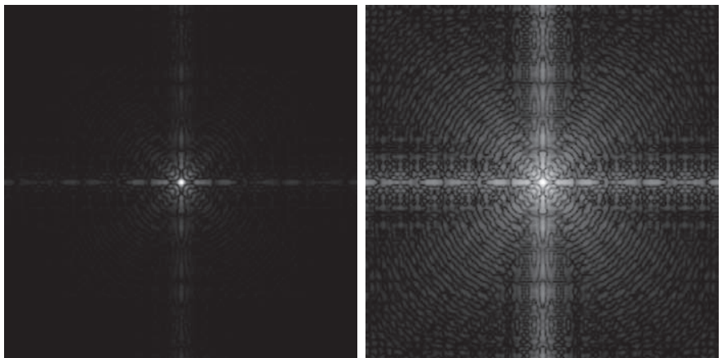
1. BASIC TRANSFORMATION
Original Image
Result of using log transformation
Notes:
This is an example about using log transformation

Slide 9
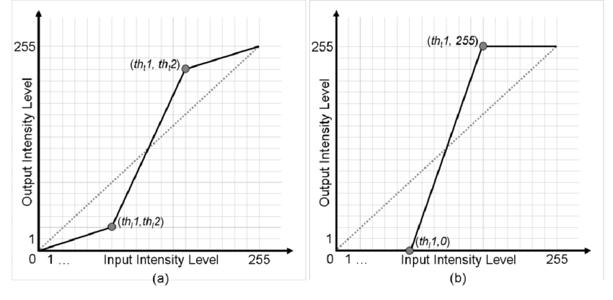
Contrast stretching
s2
s2
s1
s1
r1
r2
r1
r2
Low contrast Image
High contrast Image
Linear stretching
Peacewise Linear stretching
Notes:
"Let's move on to the next method for enhancing low-contrast images, which is contrast stretching.“
Linear stretching A simple image enhancement technique that increases contrast by expanding the range of pixel intensities. Using the linear Stretching Formula with s denote output intensity levels and r denote input intensity levels.
"When r is in the range from r1 to r2, s ranges from 0 to 255.“The output evenly spans all grayscale levels.
Piecewise Linear Stretching is an advanced technique compared to Linear Stretching, where the image contrast is enhanced by applying linear transformations to different intensity segments. It increases contrast more effectively in images with uneven intensity distribution.
It is more flexible than linear contrast stretching when the image has regions with varying brightness.

Slide 10
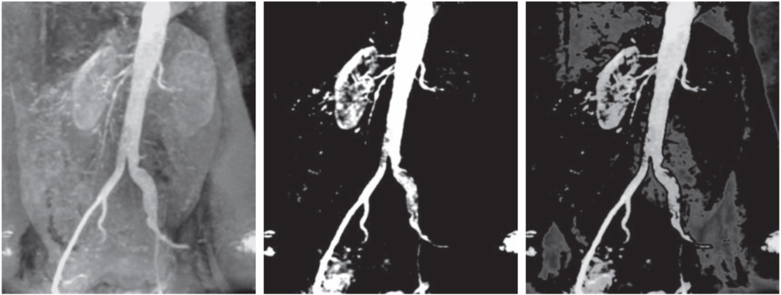
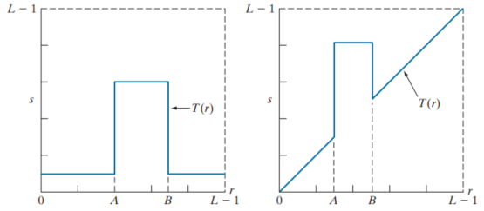
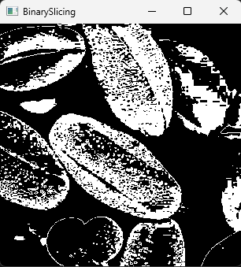
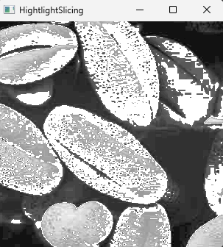
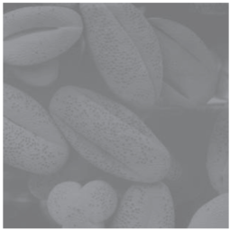
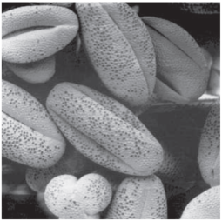
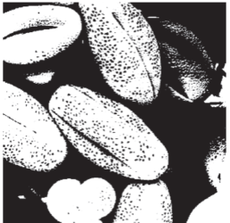
Contrast stretching
Original Image
Contrast Stretching
Thresholding
Original image
Binary slicing
Hightlight slicing
Highlights range [A, B] and reduces all other intensities to a lower level.
Highlights range [A, B] and leaves other intensities unchanged.
An X-ray imaging technique of blood vessels using contrast dye, which helps visualize the shape and condition of the vessels clearly.
Notes:
Another is gray-level slicing, which highlights a specific range of gray values to isolate certain features.
Other internal organs remain clearly visible.

Slide 11
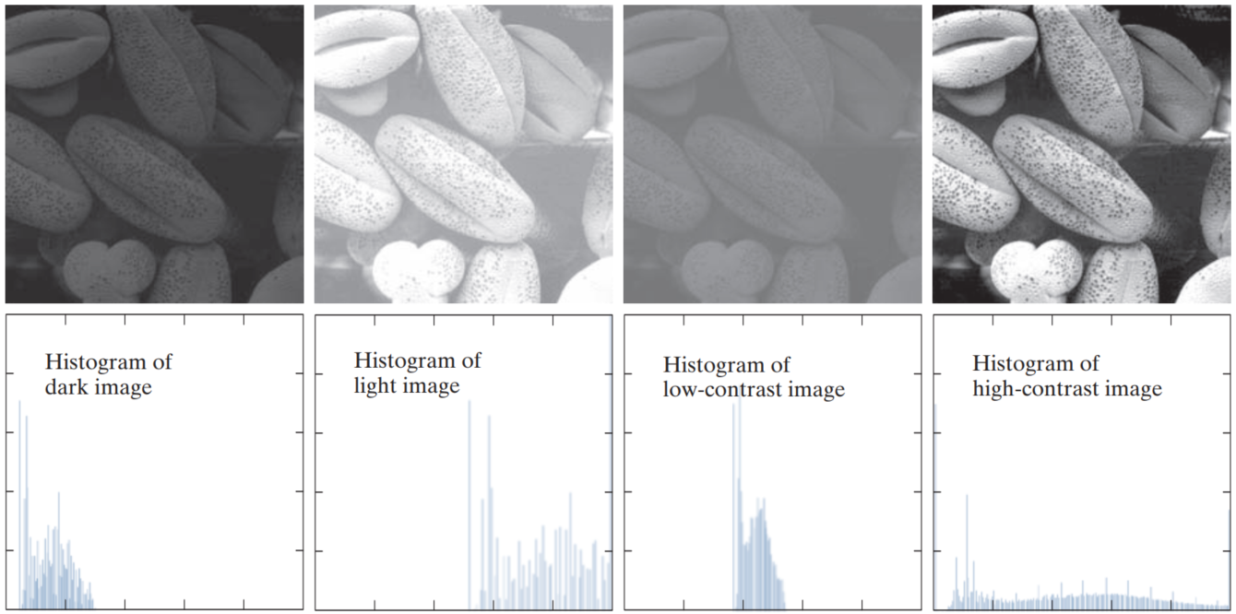
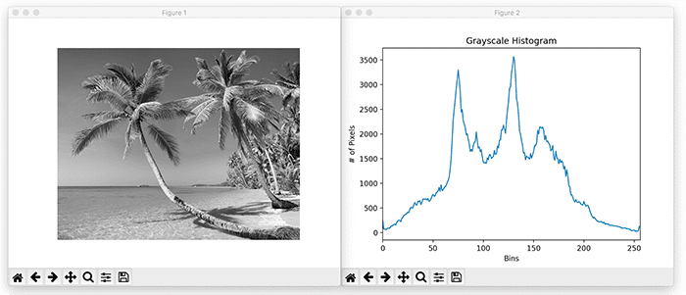
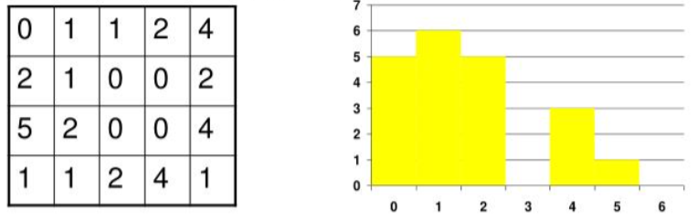
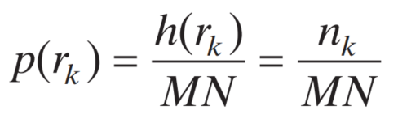
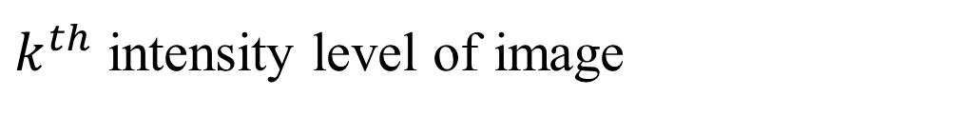
02. HISTOGRAM ANALYSIS
Normalize histogram:
A Histogram is a chart that shows how pixel intensity values are distributed in an image.
Histogram value at intensity rk
Probability of intensity rk
The number of pixels with intensity rk
$k^{th}$ intensity level of image
Image
Histogram
M and N are the number of image rows and columns M x N is Total number of pixels
The number of pixels with intensity value 0 is 5
Dark
Light
Low contrast
High contrast
Notes:
“Now let’s move into histograms. A histogram shows how often each gray level appears in the image. From this, we can tell whether an image is underexposed, overexposed, or low in contrast.
For example, if most of the pixel values are clustered toward the left side of the histogram, the image is likely too dark — underexposed. If they are grouped toward the right, the image may be too bright — overexposed.
A well-contrasted image typically has a histogram that stretches across a wide range of intensities. On the other hand, a low-contrast image will have a narrow histogram, meaning most pixels fall within a small range of gray levels.
Histogram analysis helps us decide whether and how we should adjust the image to improve its visual quality.” We need to adjust the image so that the histogram changes from this shape to something like this
The histogram has the following formula:
To simplify the calculations, we can normalize the histogram by converting absolute counts into probabilities, making it independent of the image size.

Slide 12
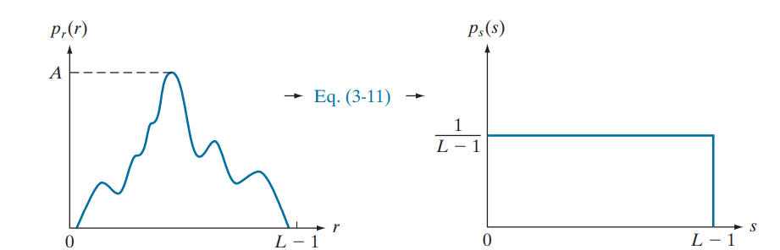
02. HISTOGRAM ANALYSIS
The goal is to redistribute the pixel intensity values so that all levels occur with approximately equal probability, resulting in a more uniform histogram.
Original histogram
Equalization histogram

Slide 13
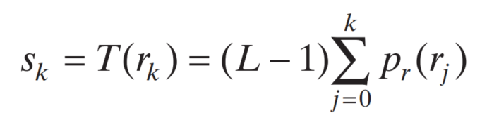
Histogram Equalization
Using the Cumulative distribution function (CDF), to remap the original pixel values.
Toal of intensity levels
The probability of intensity level
Transformation function
Output intensity levels
Cumulative proportion of pixels with gray levels less than or equal to k
Notes:
CDF (Cumulative Distribution Function) maps original pixel values to new ones based on cumulative probability.
Helps spread intensity levels across the full range [0,255][0, 255][0,255], enhancing contrast.

Slide 14
Histogram Equalization
Using the Cumulative distribution function (CDF), to remap the original pixel values.
Toal of intensity levels
The probability of intensity level
Output intensity levels
Transformation function
Cumulative proportion of pixels with gray levels less than or equal to k
Notes:
CDF (Cumulative Distribution Function) maps original pixel values to new ones based on cumulative probability.
Helps spread intensity levels across the full range [0,255][0, 255][0,255], enhancing contrast.
It tells us how intensities are distributed and accumulated throughout the image.

Slide 15
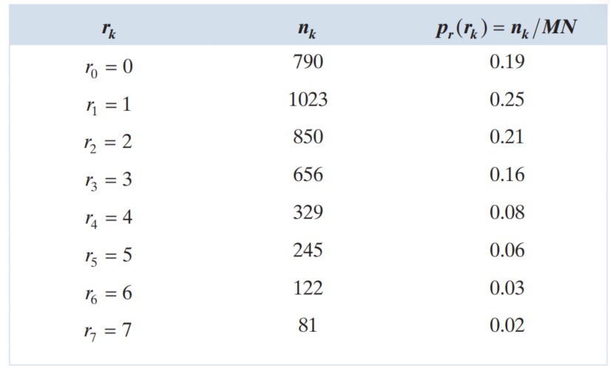
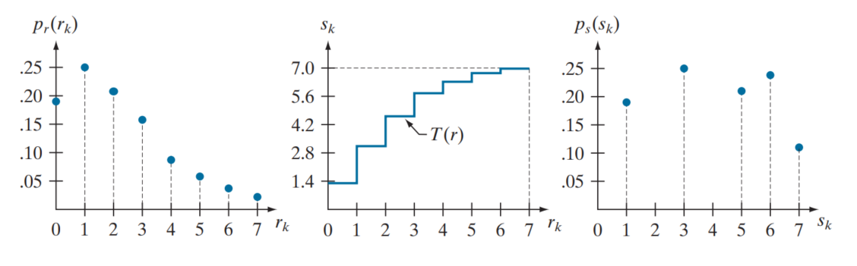
Histogram Equalization Example
Original histogram
Transformation function
Result of histogram equalization
Notes:
"Let’s look at an example. Suppose we have an image with intensity level rk, where the number of pixels at that level is nk​, and the corresponding probability of occurrence is p(rk)
"After performing the calculations using the CDF function, we obtain the corresponding output intensity levels s as follows:“
"As we can see, the histogram after equalization is more spread out and balanced compared to the original one. This indicates that the contrast has been enhanced, making the image details more visible and easier to analyze."

Slide 16
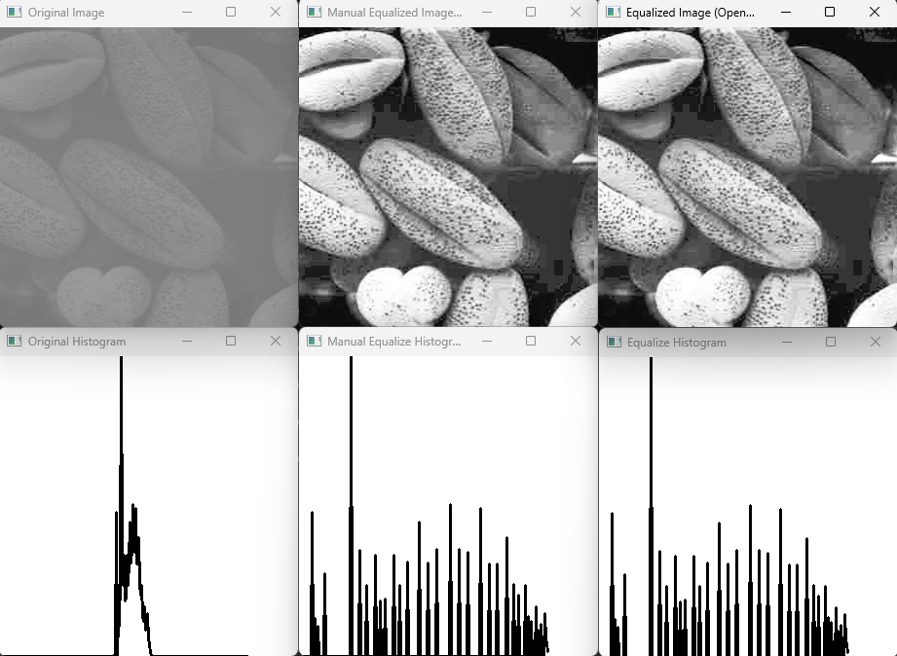
Histogram Equalization
Notes:
"These are the images and their corresponding histograms. The first image is the original one with poor contrast. The second image is the result of applying histogram equalization using my own implementation. The third image shows the result using OpenCV’s built-in function.“
Both methods significantly improve contrast. The overall appearance is similar, but slight differences in intensity levels may appear. but slight differences in intensity levels may appear due to rounding behavior and precision. Both approaches achieve the goal of contrast enhancement but OpenCV’s method offers simplicity and efficiency.

Slide 17
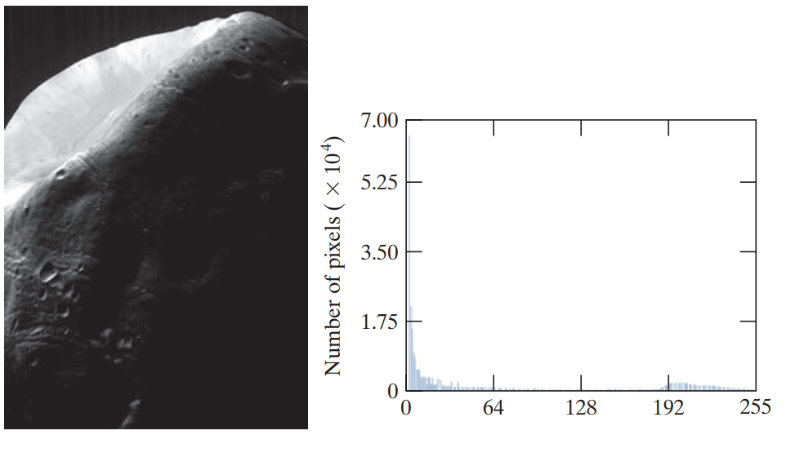
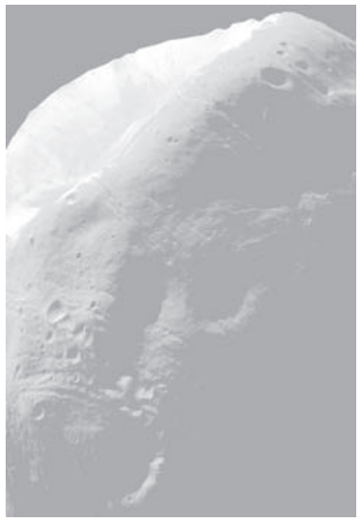
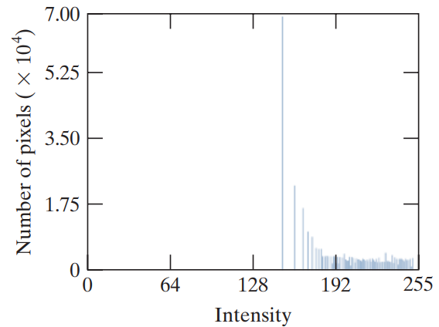
Histogram Matching
Original image
Histogram of Original image
Histogram equalized image.
Histogram of equalized image.
Notes:
Histogram Equalization aims to redistribute the pixel intensities across the full range of values, it depends on the input image's histogram and may produce results that are not always visually pleasing, especially in cases where the image has a skewed intensity distribution.
Histogram Matching is a technique that is often used when Histogram Equalization is not sufficient or when you want the output image to match a specific desired appearance
Histogram Matching allows for more control by transforming the input image's histogram to match a reference image's histogram, ensuring the output image has the desired contrast and brightness characteristics, regardless of the input image's original distribution.

Slide 18
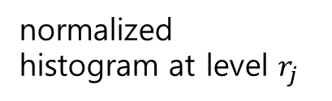
Histogram Matching
Steps for Histogram Matching with Discrete Quantities
Step 1: Compute the cumulative distribution function (CDF) from the input image's histogram:
The original intensity level in the input image.
Number of intensity levels (typically 256)
The new intensity value after histogram equalization.
normalized histogram at level $r_{j}$
Notes:
Step 1: We’ll Compute the cumulative distribution function (CDF) from the input image's histogram:

Slide 19
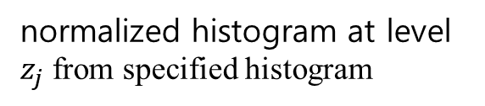
Histogram Matching
Steps for Histogram Matching with Discrete Quantities
Step 1: Compute the Specified Histogram CDF
The intensity level in the specifided image.
Number of intensity levels (typically 256)
normalized histogram at level $z_{j}$ from specified histogram
Notes:
Next, we compute the Specified Histogram CDF

Slide 20
Histogram Matching
Steps for Histogram Matching with Discrete Quantities
Step 3: Create the Mapping Between Levels
For each source level $r_{k}$​, find the target level $z_{q}$​ such that:
In practice, you find the ​$z_{q}$​ that minimizes:
Step 4: Create the Mapping Between Levels
For every pixel in the source image with value $r_{k}$, replace it with $z_{q}$​​ according to the mapping table.
Notes:
In this part, we introduce histogram matching using discrete quantities. The goal is to adjust the gray levels of a source image so that its histogram closely resembles that of a target image.“
"Now, for each gray level in the source image, we look for the closest matching CDF value in the target image. This gives us a mapping from source levels to target levels — essentially a lookup table.“
"Once we have the mapping table, we apply it to every pixel in the source image. This replaces each pixel value with the corresponding value from the target image, completing the histogram matching."

Slide 21
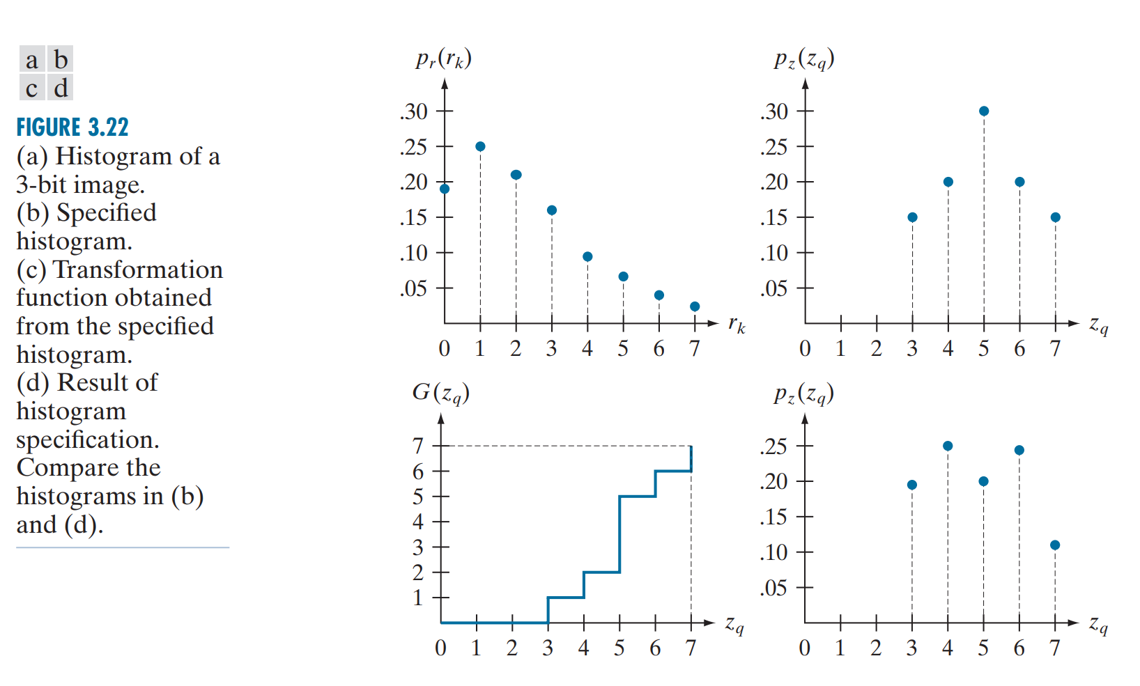
Histogram Matching Example
Notes:
In this part, we introduce histogram matching using discrete quantities. The goal is to adjust the gray levels of a source image so that its histogram closely resembles that of a target image.“
"Now, for each gray level in the source image, we look for the closest matching CDF value in the target image. This gives us a mapping from source levels to target levels — essentially a lookup table.“
"Once we have the mapping table, we apply it to every pixel in the source image. This replaces each pixel value with the corresponding value from the target image, completing the histogram matching."

Slide 22
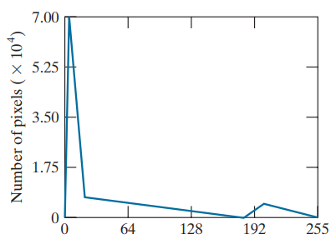
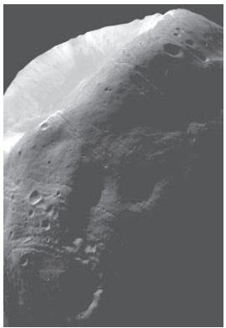
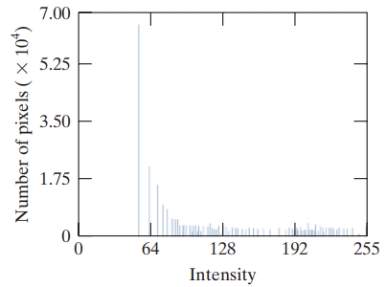
Histogram Matching Example
Specified histogram.
Histogram of equalized image.
Result of histogram specification.
Histogram equalized image.
Histogram of image result
Notes:
Compared to histogram equalization, histogram matching often gives a more visually pleasing result.

Slide 23
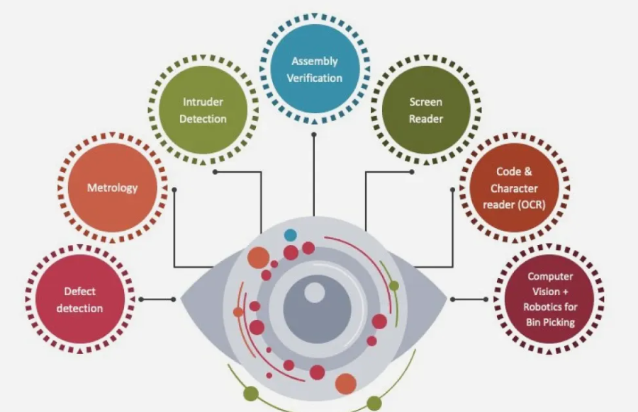


03. CONCLUSION
SUMMARY
Intensity transformations help us control image brightness and contrast, while histogram techniques give us tools to analyze and enhance pixel distributions. These methods are simple yet very effective, and form the basis of many image processing pipelines.”
Future Work & Applications
Going forward, these techniques are widely used in areas like medical diagnostics, satellite imagery, and automated quality inspection. When combined with modern AI, they can improve both the input data and the model performance.

Slide 24

Thanks
주식회사 자비스
XAVIS Co,.Ltd.
Tel:031-740-3800 Fax: 031-740-3802
Email: xavis@xavis.co.kr URL: www.xavis.co.kr

